Slide 1

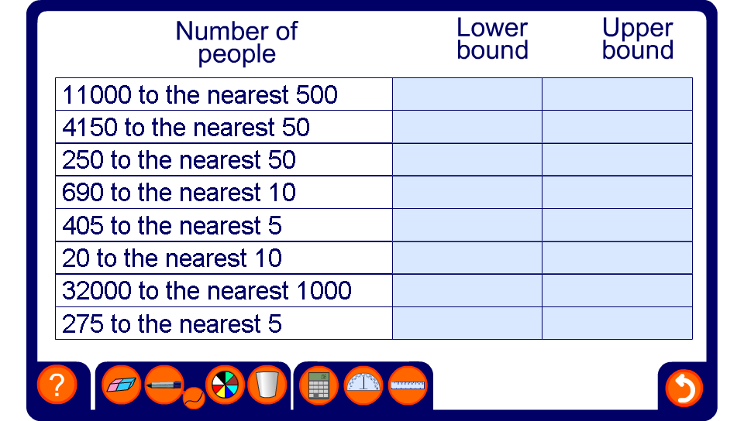


Upper and lower bounds for discrete data

